Slide 1
People You
Work With

Slide 2
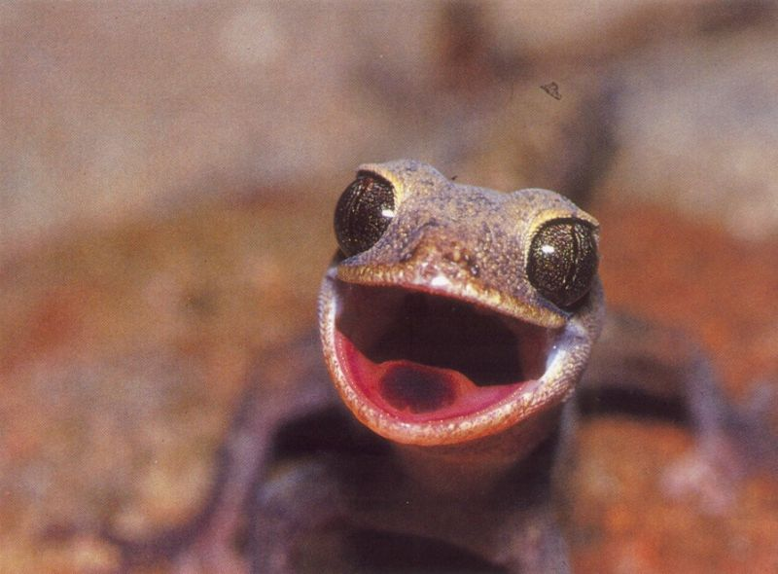
Happy

Slide 3
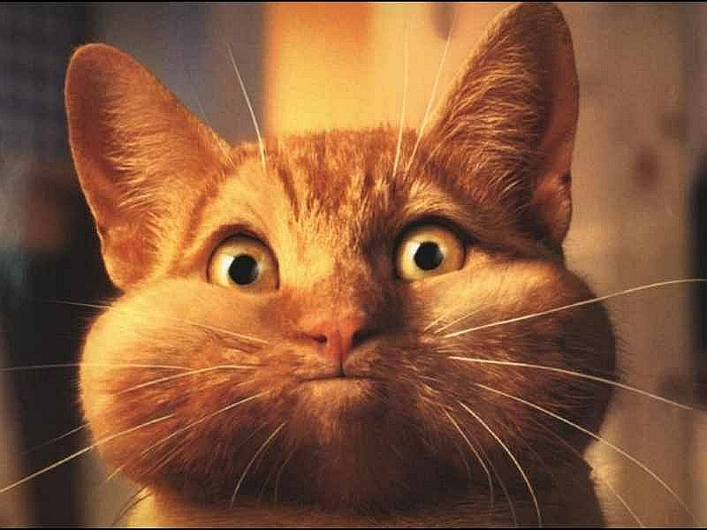
Greedy

Slide 4
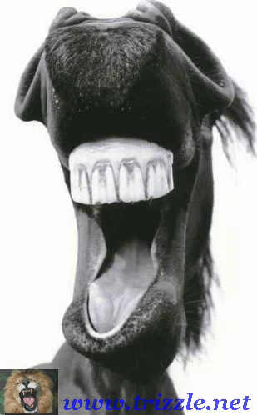
The Joker

Slide 5
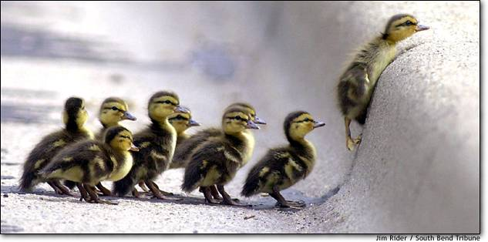
The Leader

Slide 6
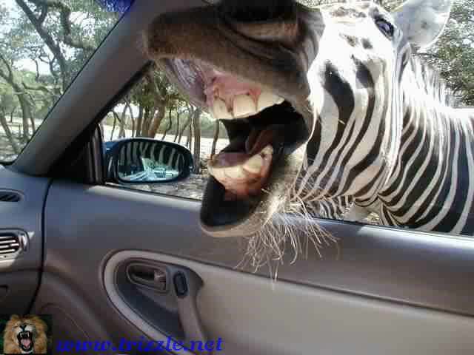
The Loud Mouth

Slide 7
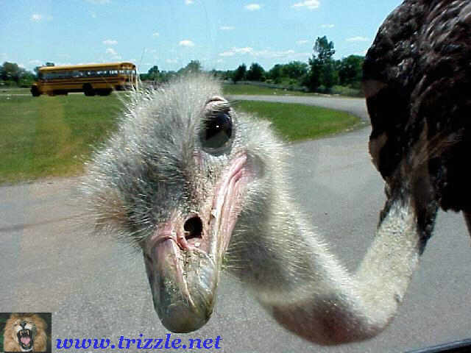
The Busy Body

Slide 8
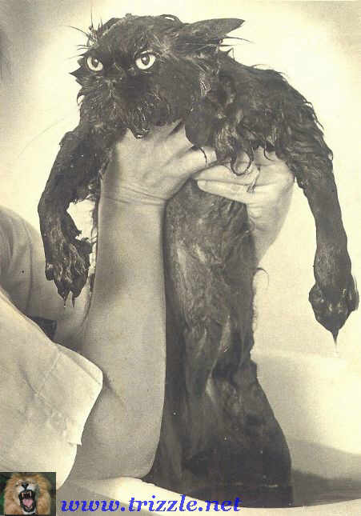
Disgruntled One

Slide 9
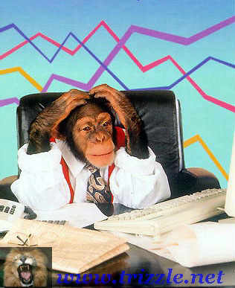
The Informatics Specialist

Slide 10
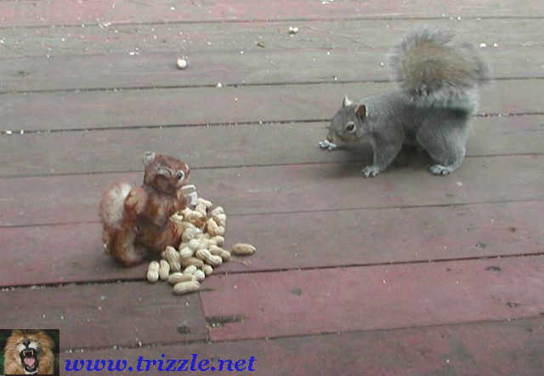
Keeper of the Nuts

Slide 11
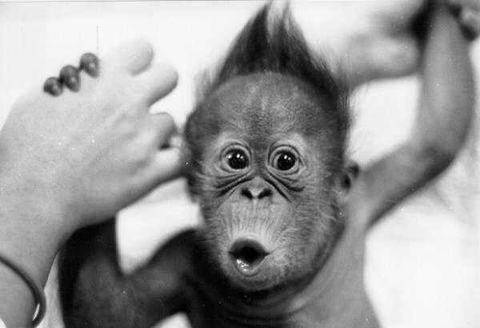
The New Guy

Slide 12

The Expert

Slide 13
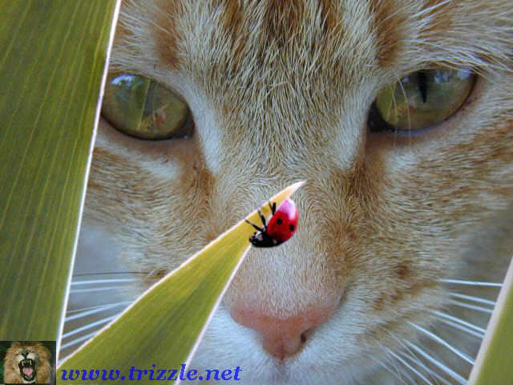
The Supervisor

Slide 14
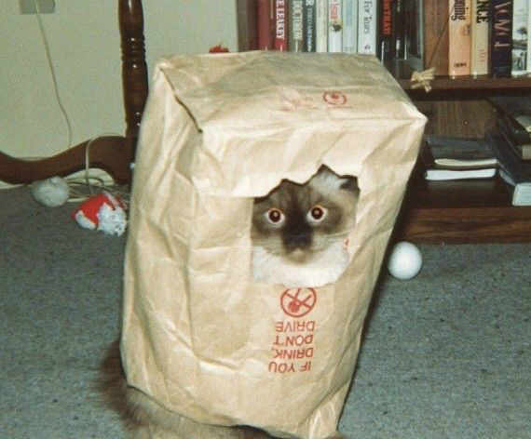
The Mole

Slide 15
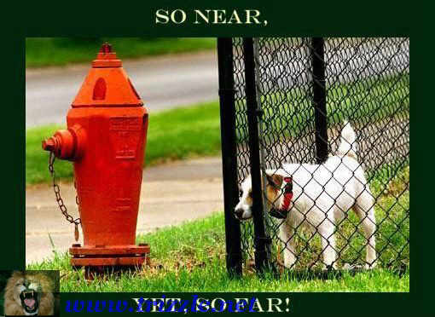
The Frustrated Employee

Slide 16


Exploring Personality Types:
Finding Your True Colors

Slide 17
Objectives
Identify Your Personality Style
Understand 4 Basic Styles
Understand Strengths & Weaknesses
Build Positive & Satisfying Relationships
Understand how your Style can impact the team

Slide 18
Personality Styles
Why Bother?
Helps understand people better
People learn in different ways
Process information differently
Communicate differently
Relationship building differences
Values/Purpose for life vary
Different Goals

Slide 19
Color Types
Complete True Colors Questionnaire
What is your True Color?

Slide 20
Traditionalists - Guardian - GOLD
See world as facts and realities
Want to organize them
Give stabilization to organization
Strengths: Practical
  Decisive
  Planning
  Dependable
  Systematic follow through
Weakness: “A rule is a rule is a rule”
Want to be appreciated for:
  Their careful, thorough, accurate work

Slide 21
Visionary - Rational – GREEN
See world as possibilities, meanings, relationships
Want to examine their consequences analytically and impersonally
Are architects of change
Strengths: Looking ahead and designing change
  Setting high standards
  Seeing “The Big Picture”
  Contagious enthusiasm for ideas
  Taking the challenge “it can’t be done”
Weakness: Lose people with their fascination for complexity
Want to be appreciated for: quality of their ideas and intellect

Slide 22
Catalyst - Idealist - Blue
See world as possibilities, meanings, relationships
Want to judge their value to people and for people
Get people to work effectively together
Strengths: Participative leadership
  Sensitivity, empathy
  Being creative, good marketers
  Learning new things
  Enthusiasm
Weakness: “Biting the Bullet”, hurt easily
Want to be appreciated for:
Themselves as someone who makes important contributions

Slide 23
Troubleshooter - Artisan - ORANGE
See world as facts and reality
Want more facts to manipulate
Give action, excitement, competition to organization
Strengths: Good in crisis
  Ingenious, resourceful
  Make things happen
  Flexible
  Risk takers
Weakness: “Ready, fire, aim”
Want to be appreciated for:
  The clever way they get things done

Slide 24
Blue Green Gold Orange
6% Green
44% Gold
40% Orange
10% Blue

Slide 25
Jobs and True Colors
Blues
  Concentrate on people and relationships.
  Focus on service, and health and welfare of people.
  Warm, supportive, harmonious environments where workers are free to cooperate and communicate with each other.
  Are imaginative, enthusiastic and concerned about the personal welfare of those around them.
  They dislike competition, conflict, bureaucracy and domineering authority figures
  They promote creativity, flexibility, individuality and personal expression.

Slide 26
Jobs and True Colors
Orange
Tackle their work with enthusiasm so they can quickly move on to other pursuits
They are great at working under pressure and prefer to work on jobs that are lively, risky, and unpredictable.
They grow restless with jobs that tie them down and limit their personal freedom.
They are straightforward, realistic, and practical workers who bring a flair, energy and excitement to the workplace.
They are talented, resourceful, skillful and adaptable.
They are upbeat and social in nature, and present a positive self-image of themselves and their company.
They are action-oriented workers who know how to get results they desire.

Slide 27
Jobs and True Colors
Green
Driven towards work that involves an analytical and creative focus
Visionary and independent workers who can tune out the world as they work on things that capture their interest.
Most productive when they can perfect an idea, then move on and leave the project to be maintained and supported by others.
Work well with complex strategies, abstract concepts and theoretical models.
Prefer a work environment with minimum structure and little bureaucracy.
Enjoy taking risks to test their innovative ideas.
Their biggest asset is their drive to be competent, logical and accurate.

Slide 28
Jobs and True Colors
Gold
Prefer jobs that allow them to be thorough, accurate, and systematic.
Prefer to work in situations where they can see a job through to the end, and then touch and feel the results.
Are practical, efficient and cooperative workers that respect authority, discipline and punctuality.
Work best in environments that are traditional, structured, orderly and filled with other hard-working people.
Have a compelling need to follow established procedures and routines and do things the “right” way.
Are stable, honest and dependable workers who generally put the needs of the company above their own.

Slide 29
Basic Leadership Temperaments
An understanding of personality types in general, and YOUR OWN in particular, helps to recognize and appreciate the unique GIFTS of yourself and others.
Success, in any enterprise, demands the unique skills of each type.
  Pragmatics Guardian Logistical - Gold
  Vision Rational Strategic - Green
  People Skills Idealist Diplomatic - Blue
  Analysis Artisan Tactical - Orange

Slide 30
Conclusion
10 Commandments of Color
Don’t stereotype others
Don’t try to change people
Value differences and what they bring to the team
Don’t let strengths become weaknesses
Don’t use Colors as an excuse
Keep your observations private
Give good gifts
Carry your Colored Lenses with you
Validate the strengths of each Color
Learn from Others
Notes:
Read text on screen

